Slide 1
CREDIT CARD
WEEKLY
STATUS REPORT

Slide 2
Content :
Project objective
Data from SQL
Data processing & DAX
Snapshots
Dashboard & insights

Slide 3
Project Objective :
To build a complete weekly dashboard that gives leaders and teams immediate, real-time, clear data on credit card performance.
The dashboard's purpose is to allow stakeholders to easily track trends and analyze operations to ensure effective management.

Slide 4
Import data to SQL database :
Prepare csv file
Create tables in SQL
import csv file into SQL

Slide 5
DAX Queries :
AgeGroup = SWITCH(
TRUE(),
'public cust_detail'[customer_age] < 30, "20-30",
'public cust_detail'[customer_age] >= 30 && 'public cust_detail'[customer_age] < 40, "30-40",
'public cust_detail'[customer_age] >= 40 && 'public cust_detail'[customer_age] < 50, "40-50",
'public cust_detail'[customer_age] >= 50 && 'public cust_detail'[customer_age] < 60, "50-60",
'public cust_detail'[customer_age] >= 60, "60+",
"unknown"
)
IncomeGroup = SWITCH(
TRUE(),
'public cust_detail'[income] < 35000, "Low",
'public cust_detail'[income] >= 35000 && 'public cust_detail'[income] <70000, "Med",
'public cust_detail'[income] >= 70000, "High",
"unknown"
)

Slide 6
DAX Queries :
week_num2 = WEEKNUM('public cc_detail'[week_start_date])
Revenue = 'public cc_detail'[annual_fees] + 'public cc_detail'[total_trans_amt] + 'public cc_detail'[interest_earned]
Current_week_Revenue = CALCULATE(
SUM('public cc_detail'[Revenue]),
FILTER(
ALL('public cc_detail'),
'public cc_detail'[week_num2] = MAX('public cc_detail'[week_num2])
)
)
Previous_week_Reveneue = CALCULATE(
SUM('public cc_detail'[Revenue]),
FILTER(
ALL('public cc_detail'),
'public cc_detail'[week_num2] = MAX('public cc_detail'[week_num2])-1
)
)

Slide 7
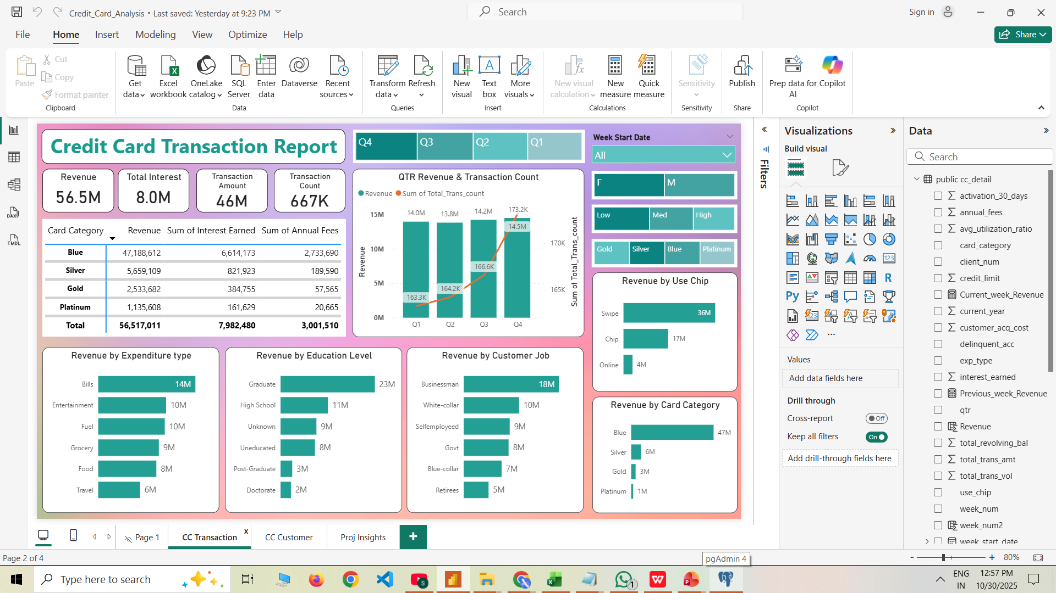
SNAPSHOTS:

Slide 8
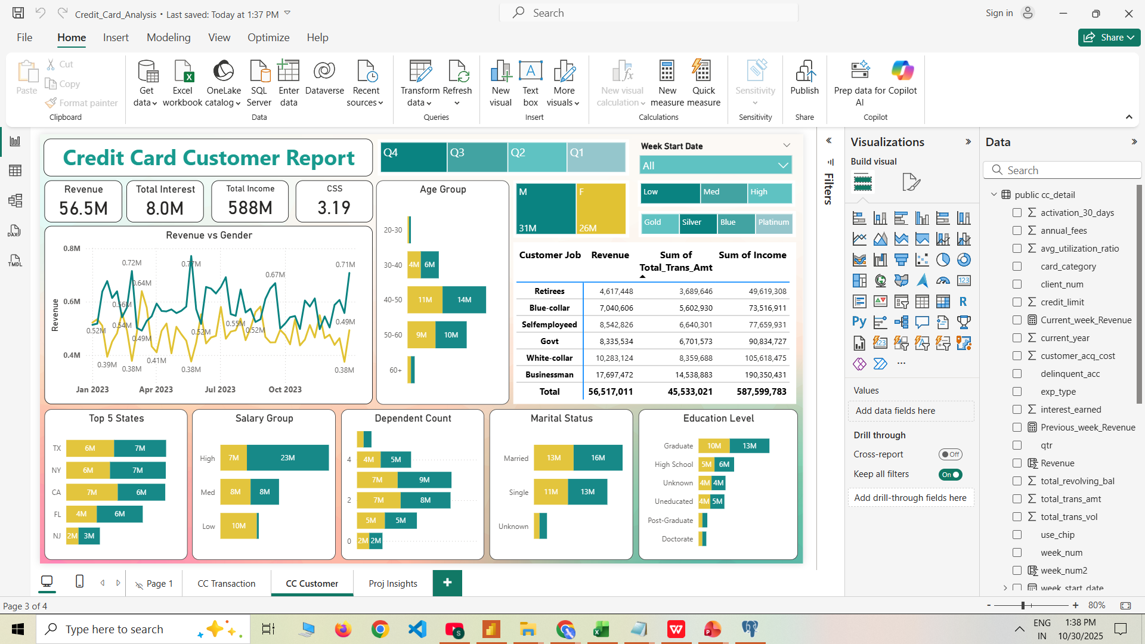
SNAPSHOTS:

Slide 9
📊 Final Project Insights: Week 53 (December 31st)
I. Week Over Week (WoW) Change:
This shows what changed from the previous week.
Revenue grew by 28.8%. This is a huge jump, meaning the last week of the year was very strong for sales.
Total Transaction Amount increased 0.35% and Count increased only 0.03%. This means customers were not swiping more often, but they were spending much more each time
they used the card.
Customer count increased by 0.28%. The number of cardholders is still growing steadily.

Slide 10
📊 Final Project Insights: Week 53 (December 31st)
II. Overview Year-to-Date (YTD):
This shows the overall performance of the card program for the whole year.
Total revenue is $56.5M. This is the total money the card program made.
Total interest is $8M. This is the income made just from revolving credit (customers paying interest).
Total transaction amount is $45.5M. This is the total value of all purchases made on the cards.
Male customers contribute more in revenue ( $31M ), compared to female customers ( $26M ). We need to find a way
to increase spending from the female segment.
Blue & Silver credit cards contribute to 93% of all transactions. Almost all activity comes from these two card types.
TX, NY, & CA are contributing 68% of the total business. The card is very popular in these three states.
Overall Activation rate is 57.5% . Over half of new cards are being used, but we need to activate the remaining cards to bring in more revenue.
Overall Delinquent rate is 6.06% . A very low number of customers are late on payments, which means the portfolio is financially healthy.

Slide 11
Thank You
- By Sahabaz Khan

